Slide 1
Team: Luna R
Week 7
Xinghai Nian, Bingzhen Chen, Xiaoqian Yang

Slide 2
Flashcards to learn a foreign language
Description: A website where users can learn a foreign language using flashcards.
Users would need to register or sign in first before they can choose a language.
Then there are two modes:
1. Study Mode: using flashcards to study.
2. Quiz Mode: Multiple choices, true and false questions.
User score, score rank, time to take the quiz will be saved.
Github: https://github.com/StacyYang/Flashcards-to-learn-a-foreign-language

Slide 3

What we’ve accomplished:
For administer account, we are able to create a administer account, and can list all user accounts, remove any account. And list quiz questions.
Milestone 2 | Frontend/backend development (home page, register, login) | week 4: 02/23/2023
Milestone 3 | Frontend/backend development (study mode design) | week 6: 03/09/2023
Milestone 4 | Frontend/backend development (quiz mode design) | week 8: 03/23/2023
Milestone 5 | Frontend/backend development (score board design) Test website, possibly deploy the website. Administer account | week 10: 4/15/2023

Slide 4

What we are doing right now:
Improve the UI of the Study mode, store notes to database.
Frontend & backend design for Scoreboard
Add more function for administer account

Slide 5
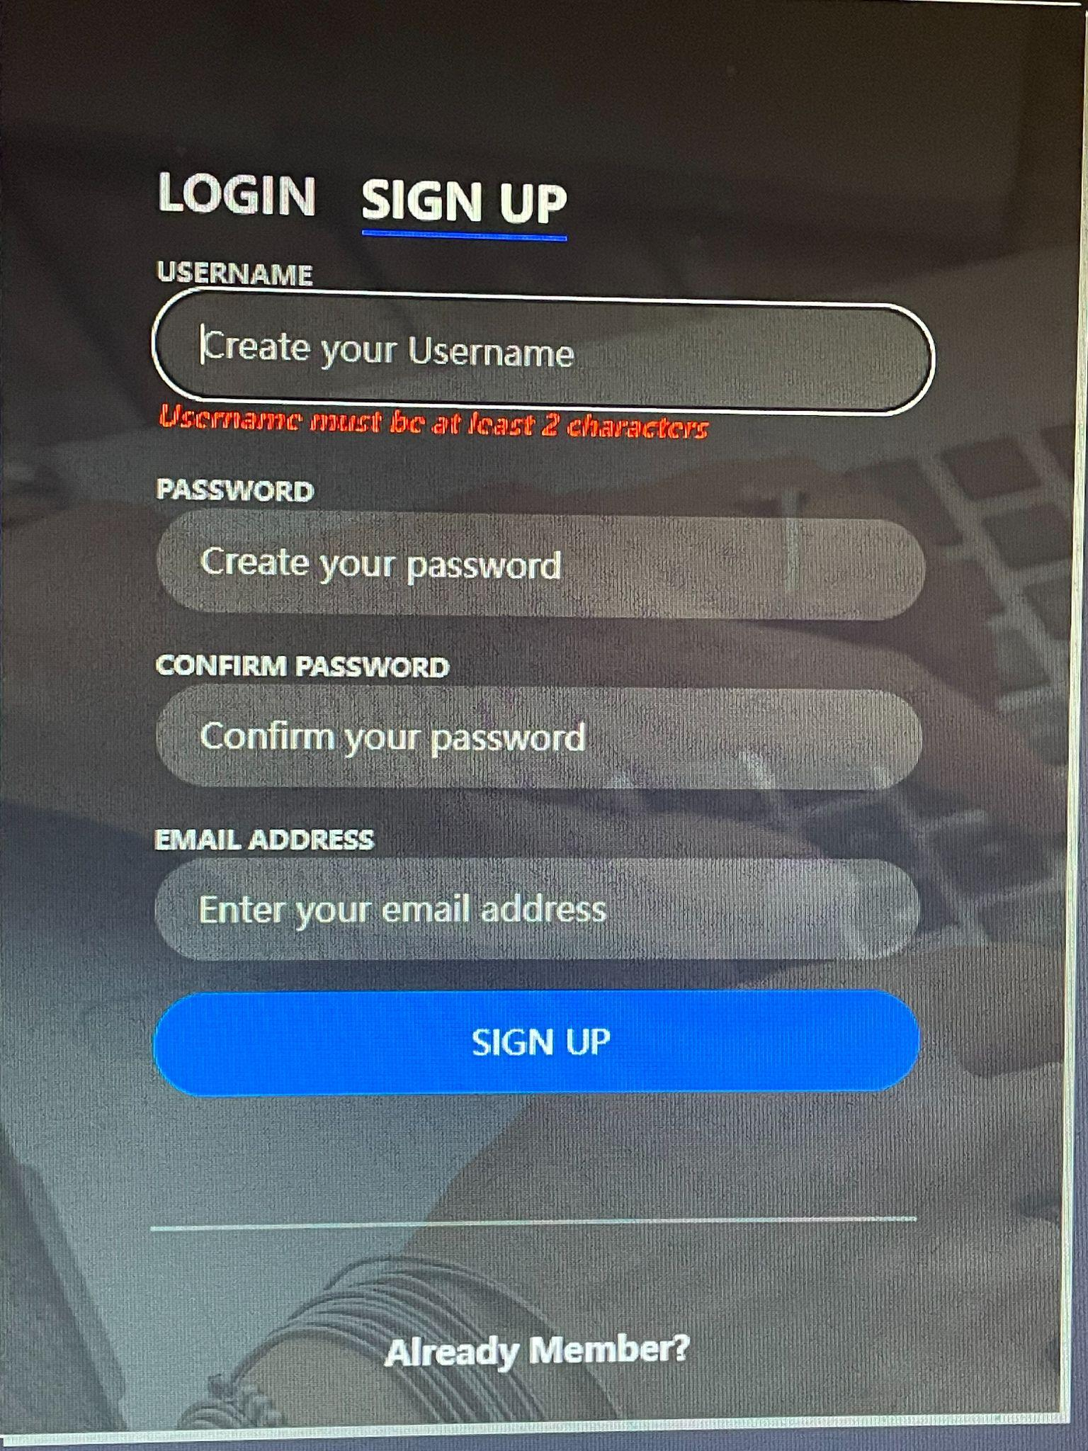
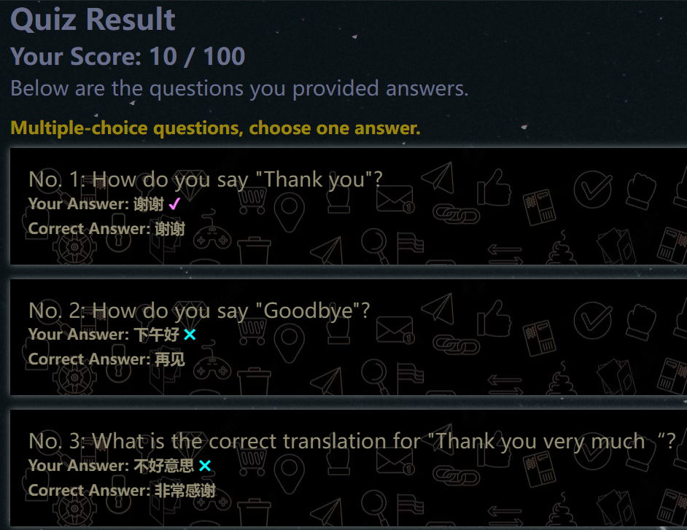
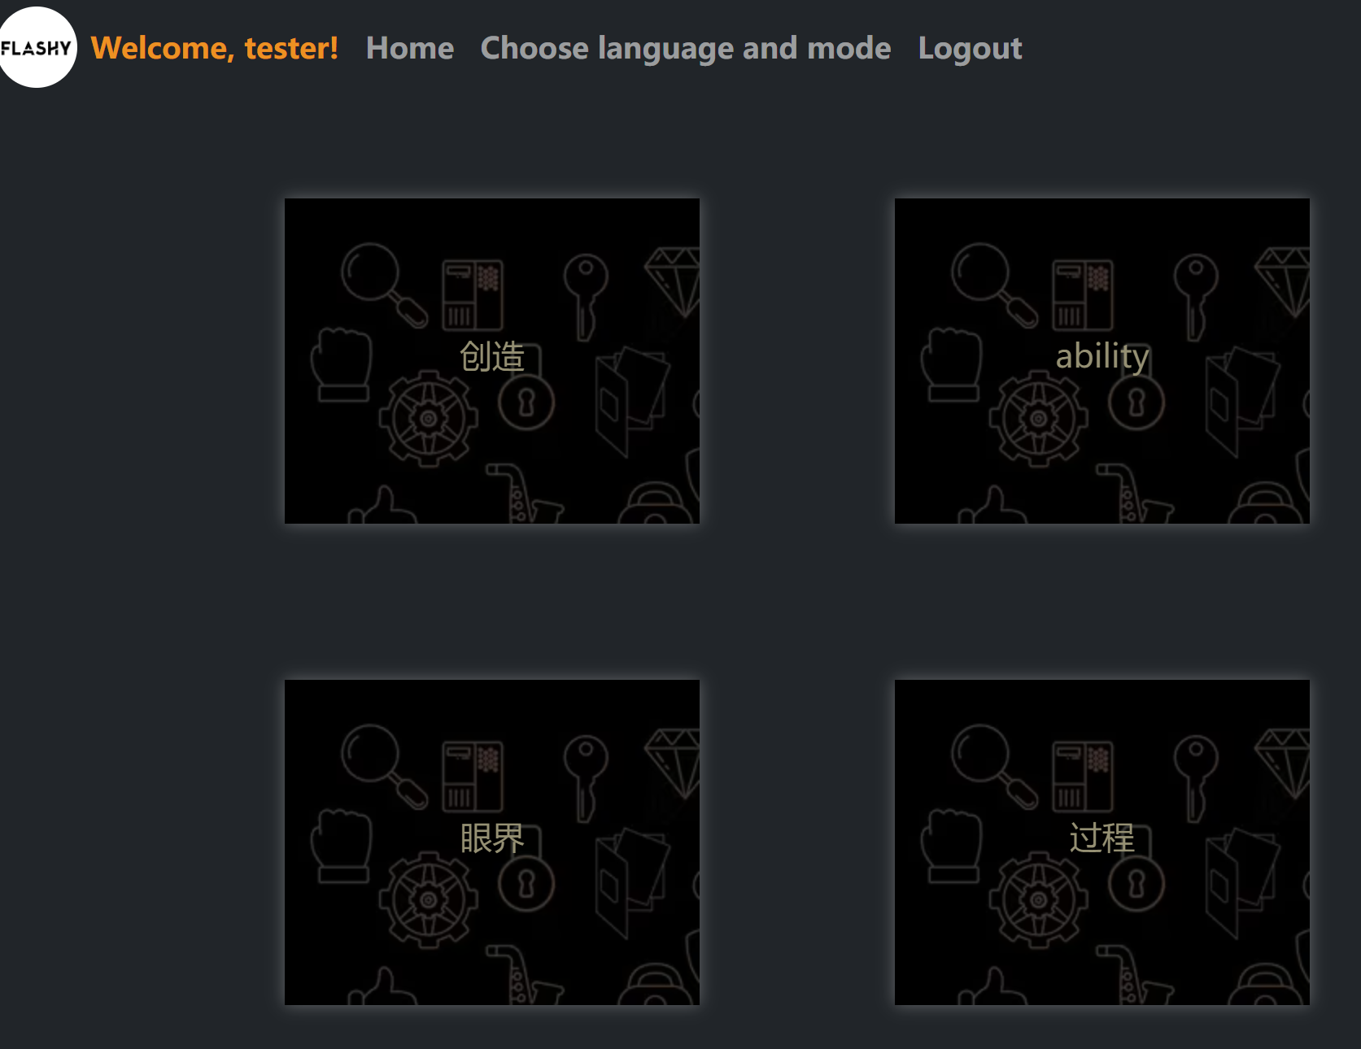
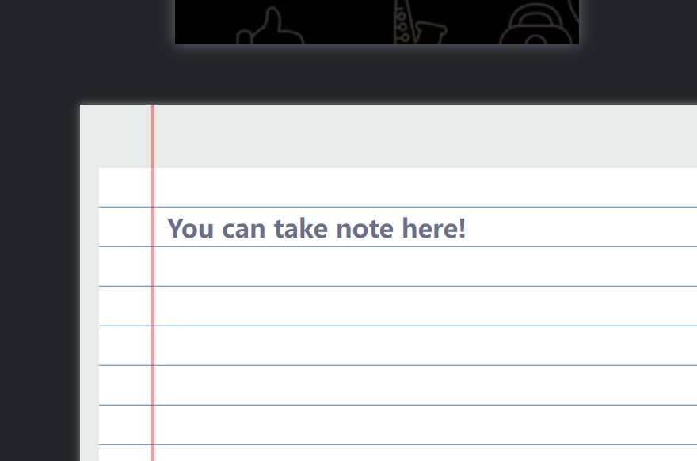
Demo screen shots
Completed Quiz Result, score and correct answer will be displayed after the user answers
Display requirements at registration
Preliminary completion of the study mode section

Slide 6
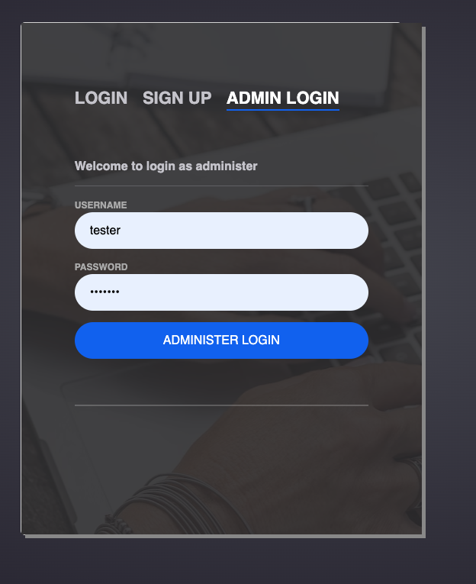
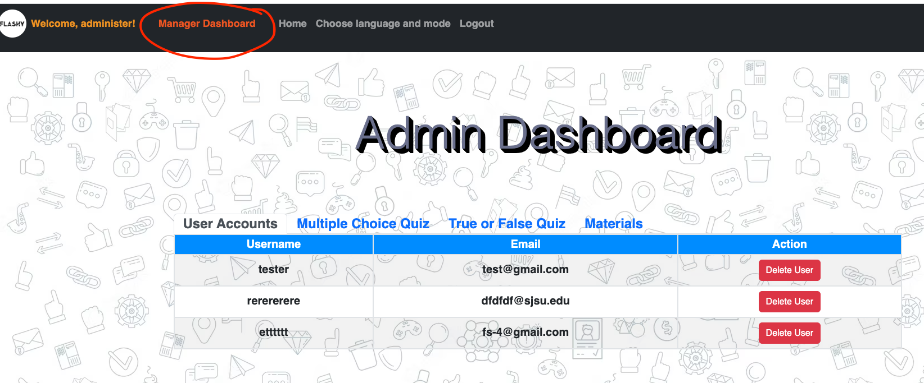
Administer account
Administer username: administer password: 1234567
Test user username: administer password: 1234567

Slide 7
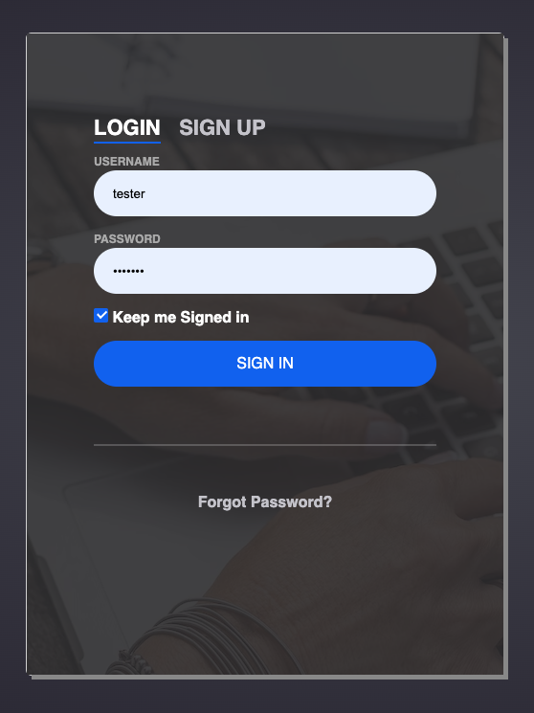
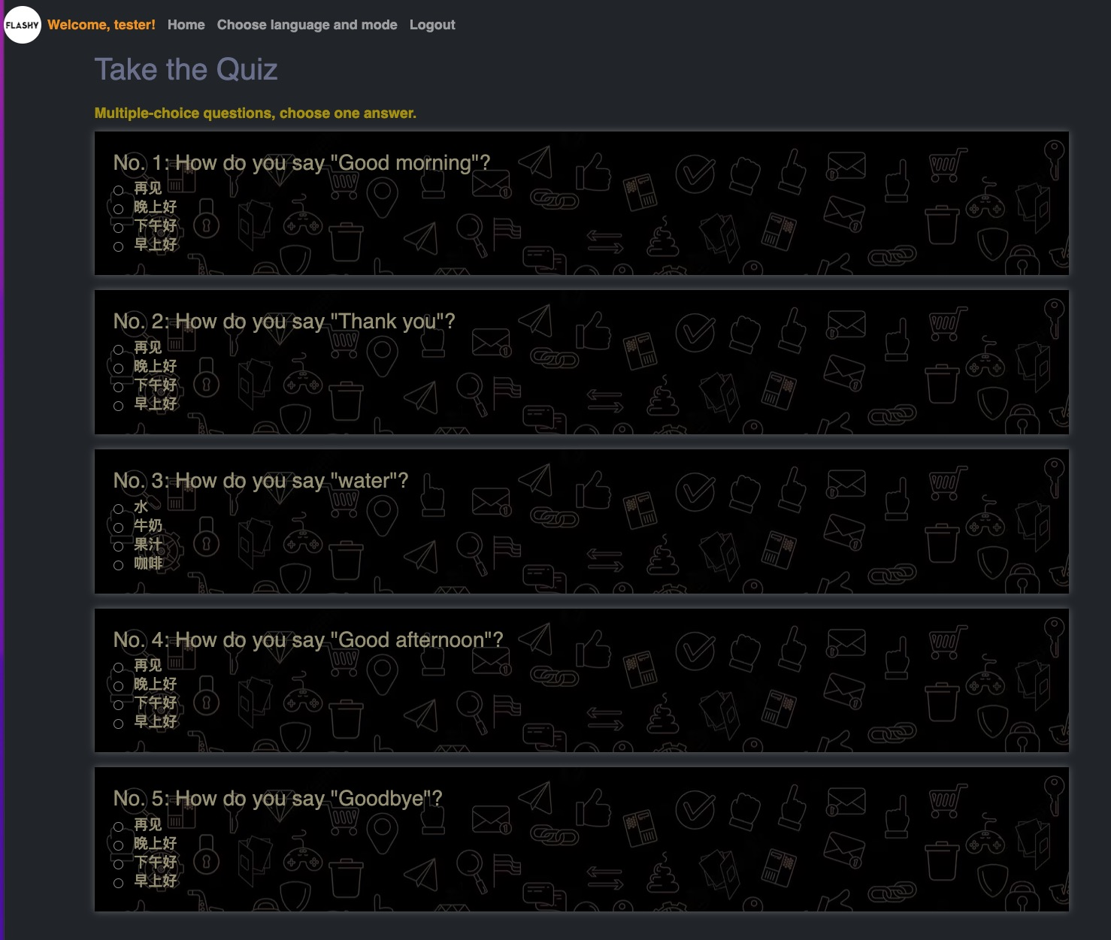
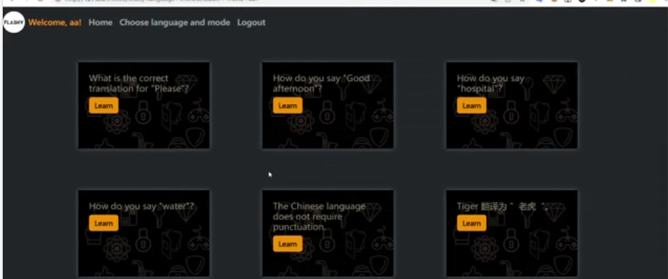
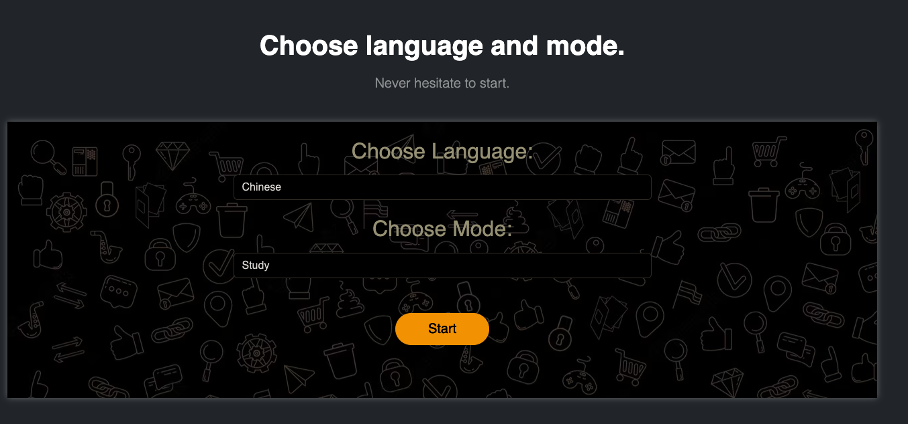
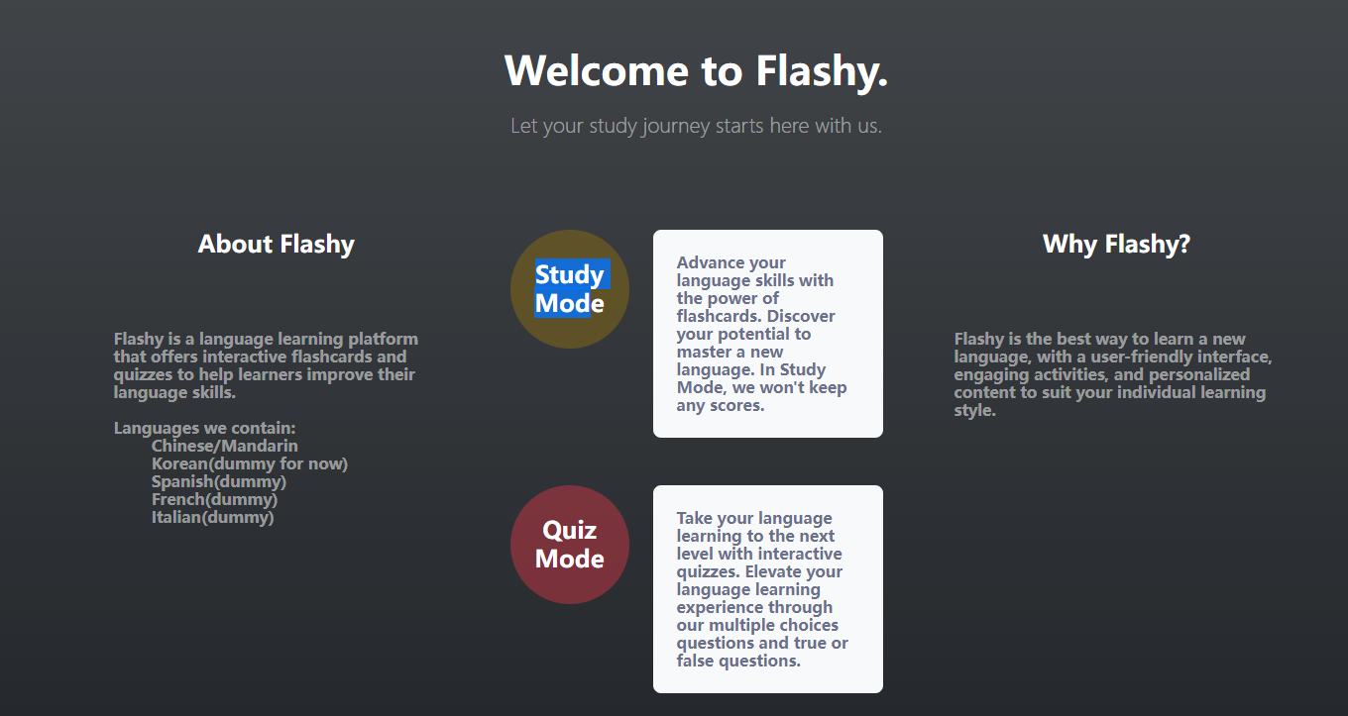
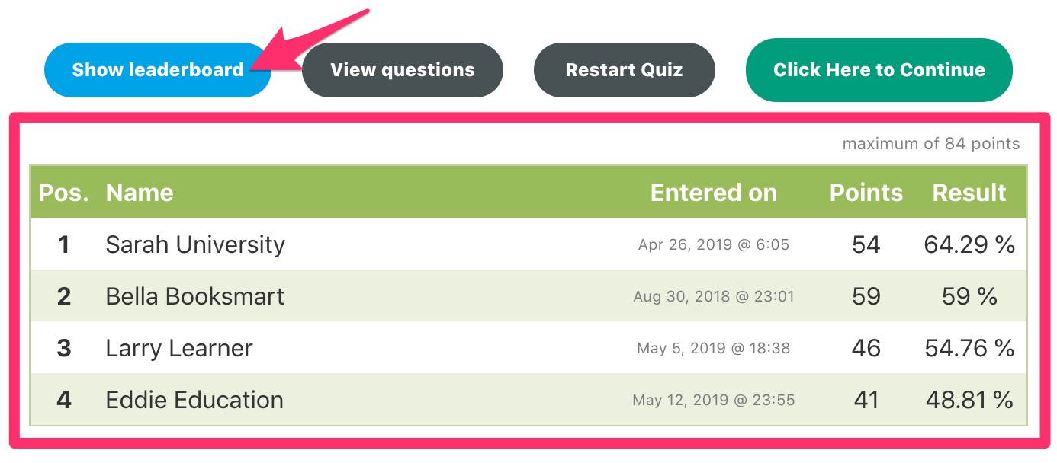
Documentation for application users
register
login
study or quiz
study by using flashcards
T/F and multiple choice questions
scoreboard after quiz

Slide 8
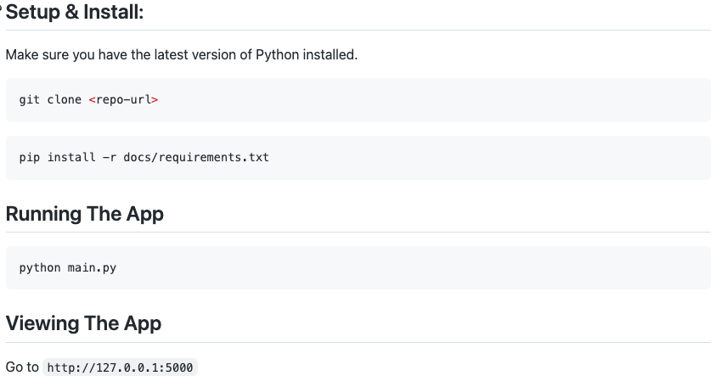



Documentation for expert users

Slide 9
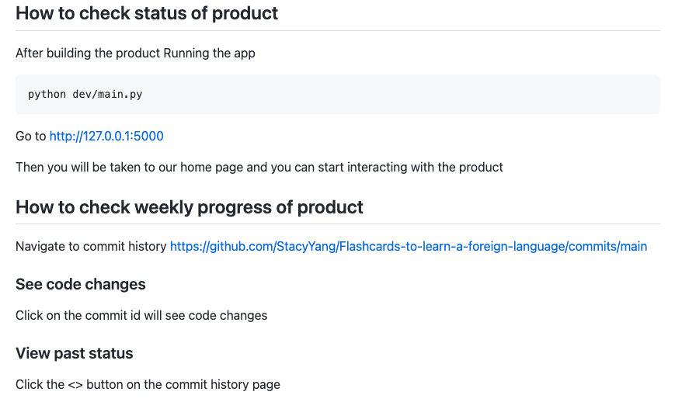

Slide 10
Testing Plan
Functionality testing:
Check that all the links on the website are working properly.
Verify that users can log in, sign up, and log out successfully.
Ensure that users are redirected to the correct pages after logging in or signing up.
Check that users are able to choose a language mode and access the quiz.
User interface testing:
Verify that the website is visually appealing and easy to navigate.
Check that all buttons and forms are properly labeled and functioning correctly.
Ensure that the website is responsive and looks good on different size of screens.
Security testing:
Check that user passwords are being stored securely (using a secure hashing algorithm).
Database testing:
Verify that user information is being stored correctly in the database.
Check that the database schema is designed properly and optimized for performance.
Performance testing:
Test the website's load times to ensure that it is loading quickly and efficiently.
Use JMeter to check that the website is able to handle a large number of users simultaneously without crashing or slowing down.

Slide 11
Supervisor account
We think it’s a good idea to have a supervisor account.
The amount of Time and effort needed: three weeks
Since we are ahead of our schedule, so it is possible for us to implements some of the features.
It is a plus to the product. Easy and reasonable to maintain the website.
Features we plan to implement:
list/summarize the individual data of registered users. (Done)
remove user accounts (Done)
(and have all the capabilities of a regular user?) (Done)
delete inappropriate quizzes and flashcards.
reset users' password (??)

Slide 12
Feedback from Codescapes
- make sure your files in weekly_team_presentation and weekly_team_report are formatted the same - ex. week1, week2, week3, ... (Will do that.)
- easy setup - documentation was easy to follow - minor change: tell users to change into dev folder before running main.py or change command to python dev/main.py (Will do that, thank you for pointing out)
Recommendation: - create an about us page - cool seeing team members, but it takes up more than half the main page (Might do that if have time)

